Slide 1


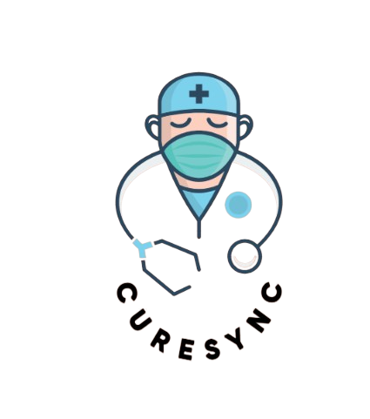
CureSync
Synchronizing Care, Healing Lives.
1

Slide 2
Presenting to :
Presented by :
Mr. Syed Eftasum Alam
MD Sharia Akter
2221-15-4929
Lecturer
Department of CSE
Daffodil International University
Riyadh Ali Mollik
221-15-5096
Dipro Paul
221-15-5666
Iftakharun Hera
221-15-4818
2

Slide 3
Table of Contents
Introduction
Problem Statement
Motivation & Objective
Feature Listing
Gap Analysis
Tools
Work Distribution
Conclusion
3

Slide 4

Introduction
A one-stop digital solution for managing medical appointments, prescriptions, billing, and patient records.
Designed for Patients, Doctors, and Admins.
Built using React.js (Frontend), Node.js + Express.js (Backend), and MySQL (Database).
4

Slide 5

Problem Statement
🩺 Problem Statement – Why CureSync?
🏥 Decentralized Appointments – Patients must visit hospitals or call to book.
📄 Scattered Medical Records – No single place to upload/view past reports.
🧑‍⚕️ Unverified Doctors – Patients risk booking with unverified professionals.
📆 Manual Schedule Management – No clarity on doctors’ hospital-wise availability.
💸 Lack of Invoicing & Tracking – No proper digital billing or medical history.
🔔 Poor Communication – No structured notifications or reminders.
5

Slide 6
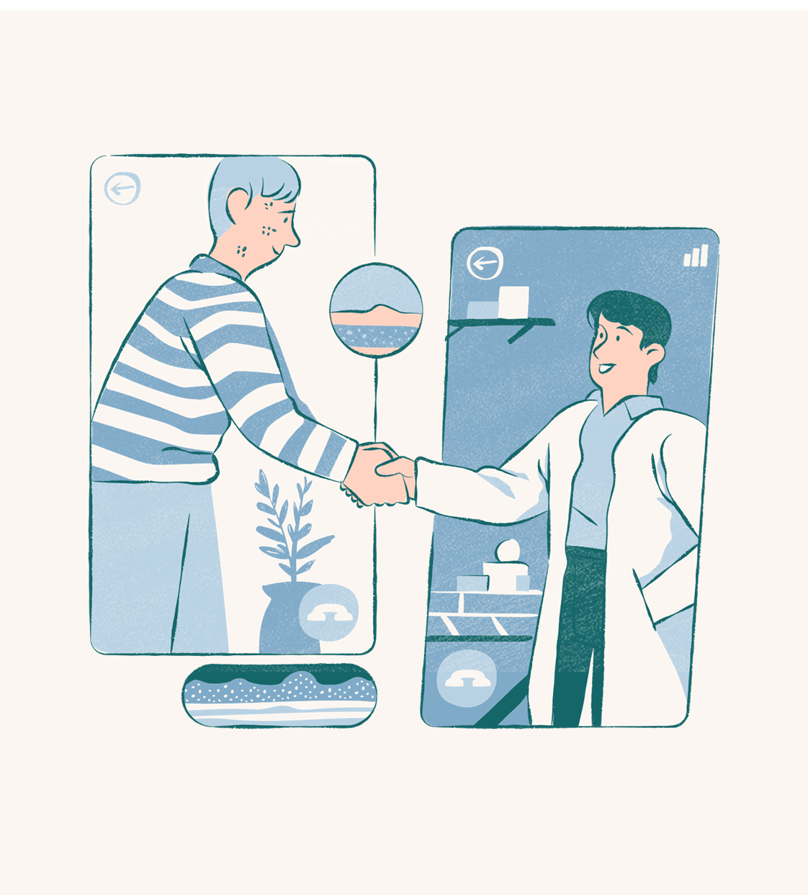
Motivation & Objectives
01.
Provide a centralized and secure healthcare portal.
Ease communication and appointment booking between doctors and patients.
02.
Streamline hospital operations such as scheduling, billing, and record management.
03.
6

Slide 7




System Users
Admin
Doctor
Manages doctor registrations, system monitoring
Manages profile, availability, appointments, prescriptions
Patient
Books appointments, uploads reports, gives feedback
7

Slide 8

Core Features
Role-based Secure Login (Admin / Doctor / Patient )
Doctor Registration with Proof Upload
Admin Approval System
Doctor Schedule Management (Day / Time / Hospital)
Doctor Appointment Booking
Medical Report Upload (PDF)
Prescription Generation
Medical Test Reports Upload
Billing & Invoicing
In-Built Currency Payment Gateway (Mock)
Notification System
Search / Filter Doctors & Services
Patient Feedback
8

Slide 9
Gap Analysis
Feature | CureSync Status | Industry Standard/Competitor Capability | Gap Identified | Recommendations
🏥 Multi-hospital scheduling per doctor | Supports scheduling a doctor’s availability across multiple hospital/clinic locations. | Manage all provider calendars across multiple locations. Practo requires non-overlapping clinic times (mark one as “on-call”). | Scheduling conflicts can occur if a doctor’s slots overlap across hospitals (Practo disallows overlap). | Add conflict-detection and alerts when scheduling overlaps. Allow doctors to mark on-call availability at secondary locations; unify multi-site calendars in one view.
📄 Report uploads & prescription generation | Allows uploading patient reports and generating prescriptions in PDF form. | Integrated EMR systems (like Practo Ray) enable uploading/sharing patient records. Digital prescription tools with templates and large drug catalogs are standard. | If CureSync’s tools are basic PDFs, it may lack prescription templates or database-driven recommendations. | Incorporate an EMR module or record-sharing feature. Implement prescription templates with a drug database and auto-share prescriptions.
💸 Invoicing system (virtual currency) | Uses an internal “virtual currency” for billing and invoicing. | Most use fiat currency with integrated payment gateways; some platforms explore cryptocurrency. | Virtual currency may confuse users and complicate real-world transactions; not a mainstream approach. | Offer traditional payment options (cards, wallets). Use virtual currency as a loyalty/reward system or clearly map it to real value.
📬 Real-time notifications | Sends notifications via email/app for appointments and updates. | Automated appointment reminders (SMS/email) are standard. Zocdoc sends confirmations and reminders automatically. | If limited to email only, it may underperform on patient engagement; may lack multi-channel alerts. | Support multi-channel alerts (push, SMS, email). Enable two-way messaging and customizable reminder content.
🔍 Advanced doctor search and filters | Offers search for doctors with filters (e.g., specialty, location). | Platforms like Practo and Zocdoc offer filters by availability, fees, insurance, language, etc. | If filters are basic, users may lack options like insurance, language, or fees. | Add filters for insurance, fees, language/gender, and distance. Include real-time availability and map-based search.
9

Slide 10




Tools
Frontend
Database
React.js, Tailwind CSS
MySQL
Backend
Other
Node.js, Express.js
JWT (Authentication), Multer (File Uploads), Nodemailer, VS Code, Postman, etc.
10

Slide 11

Unique Selling Points
🏥 Multi-hospital scheduling per doctor.
📄 PDF report uploads & prescription generation.
💸 Invoicing system with virtual currency.
📬 Real-time email/app notifications.
🔍 Advanced doctor search with filters.
11

Slide 12
Security
🔐
📁
📡
🔒
✅
Role-based Access Control using JWT
Secure File Uploads
REST API with status codes
Password Hashing using Bcrypt
Validation on all inputs
12

Slide 13
Future Work
Video consultation integration (Zoom/Agora)
Chat system between patient and doctor
Integration with government health IDs (e.g., NID verification)
Mobile App (React Native)
Analytics dashboard for admin insights
13

Slide 14
Work Distribution:
14

Slide 15
Conclusion
CureSync makes healthcare more accessible, manageable, and efficient.
With real-time doctor-patient connectivity, secure medical record management, and smart billing, CureSync is a complete clinic digitization platform.
15

Slide 16

Thank you!
16

